Slide 1
Genome Topology (Hi-C)
Caleb Lareau

Slide 2
Overview
Motivation
Timeline
Authors
Key Concepts
In situ
Domains/boundaries
Subcompartments
Loops
Resolution
Rao et al.

Slide 3
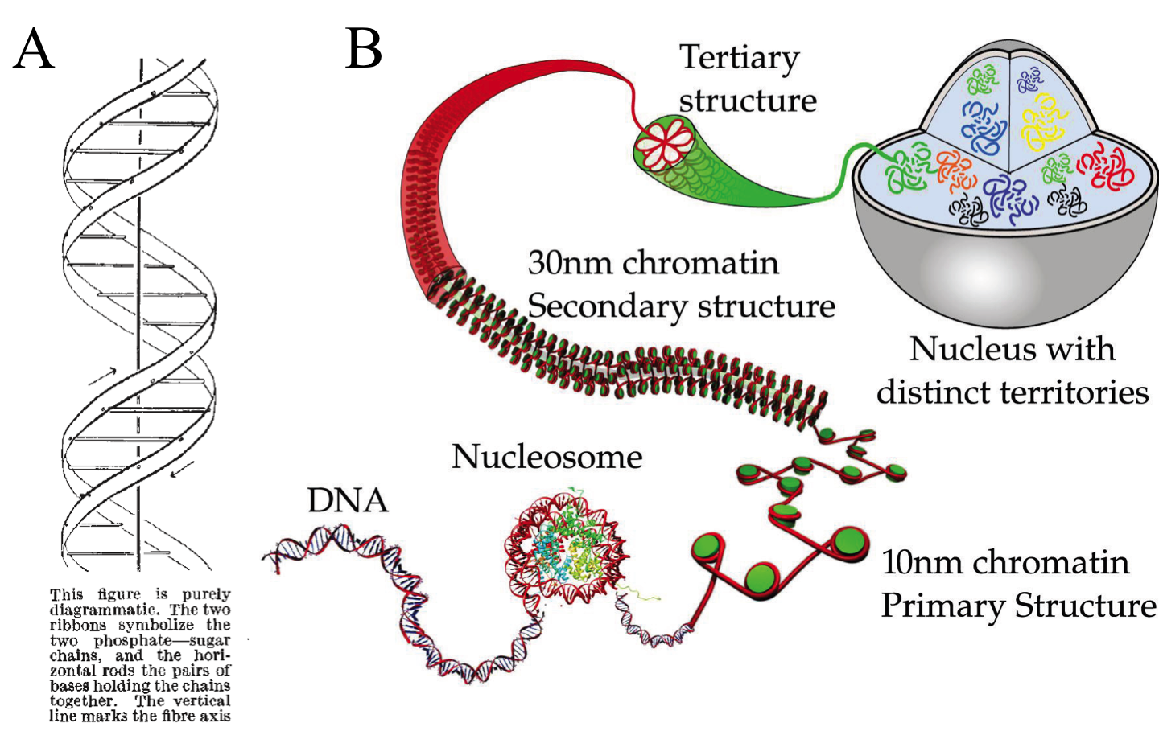

Slide 4
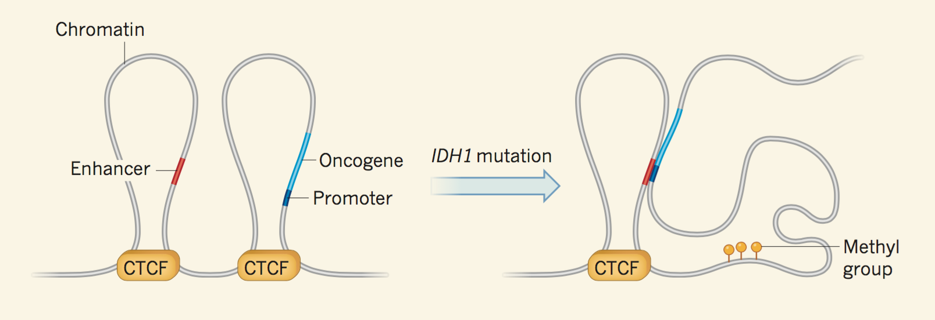
Flavahan et al 2016 (Caleb will present October 26)

Slide 5
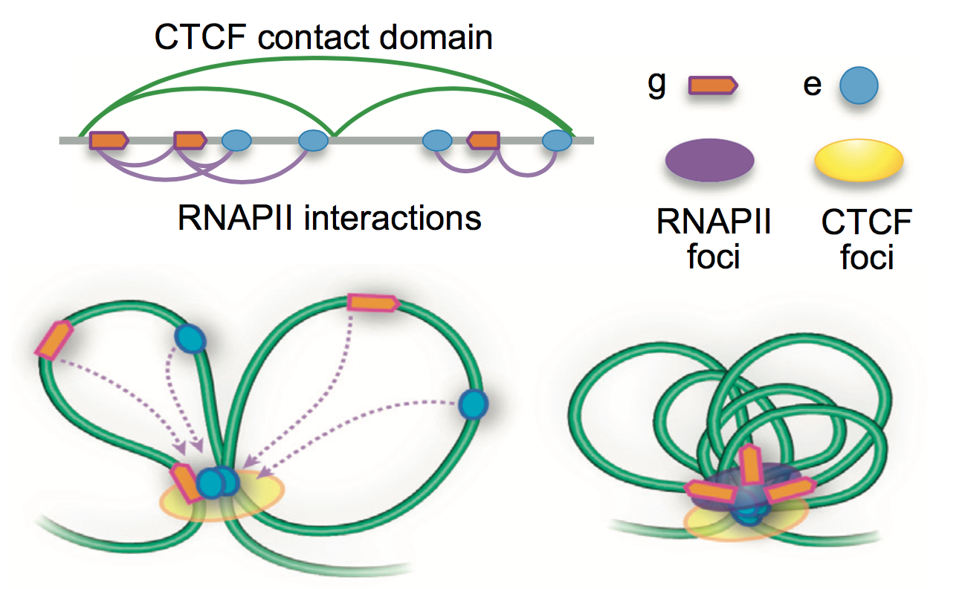

Slide 6
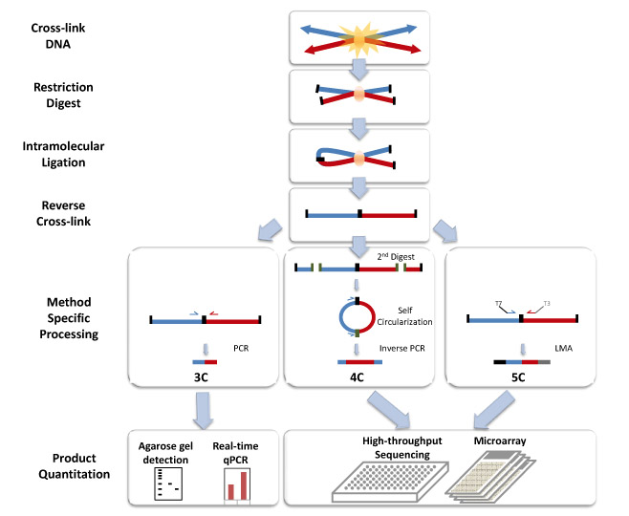

Slide 7
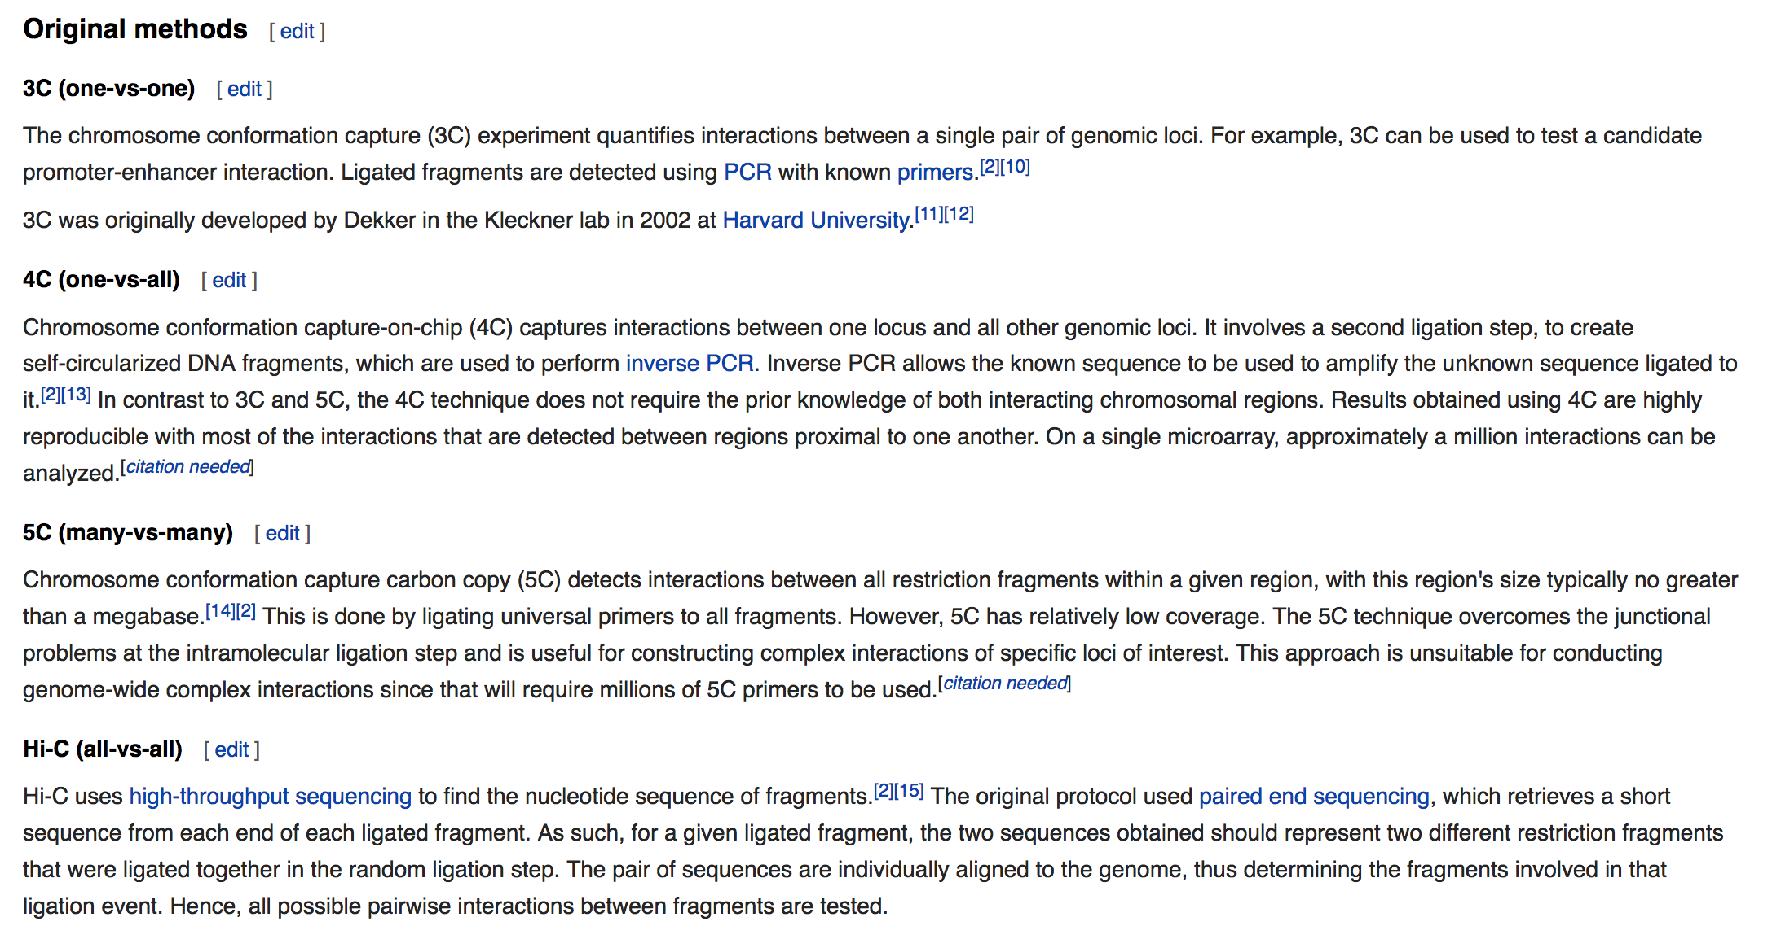

Slide 8
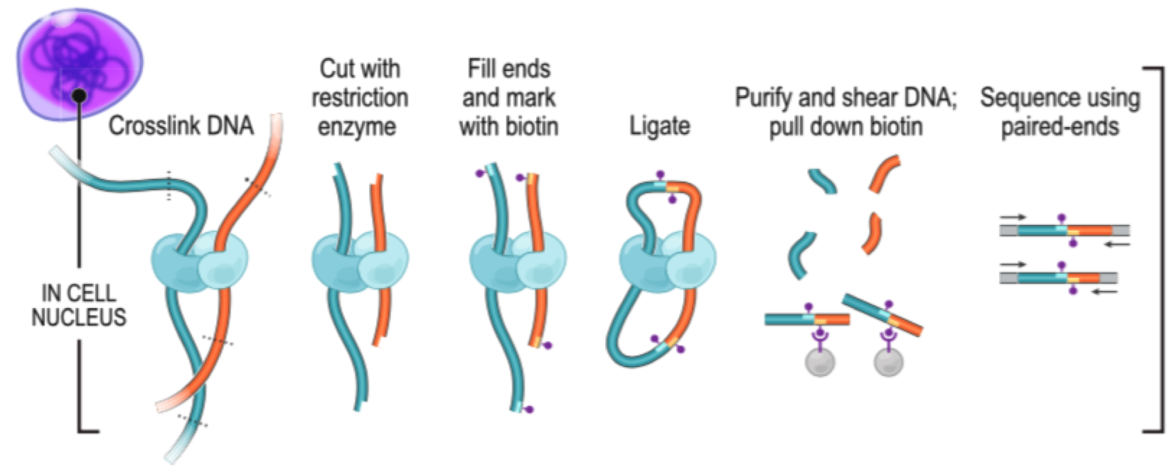
Hi-C

Slide 9
Draw Hi-C Bin/Seq Example

Slide 10
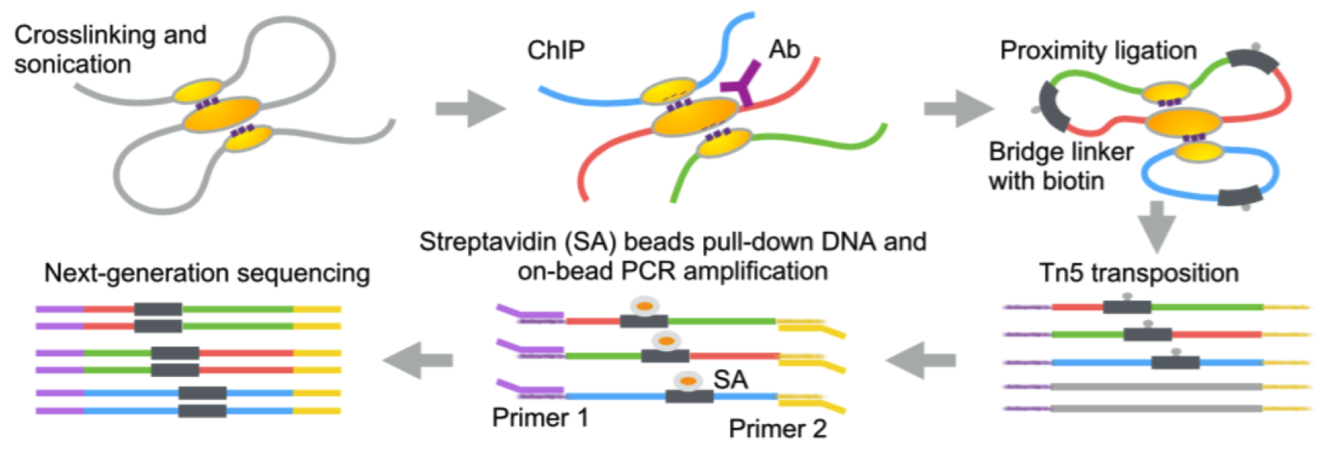
ChIA-PET

Slide 11
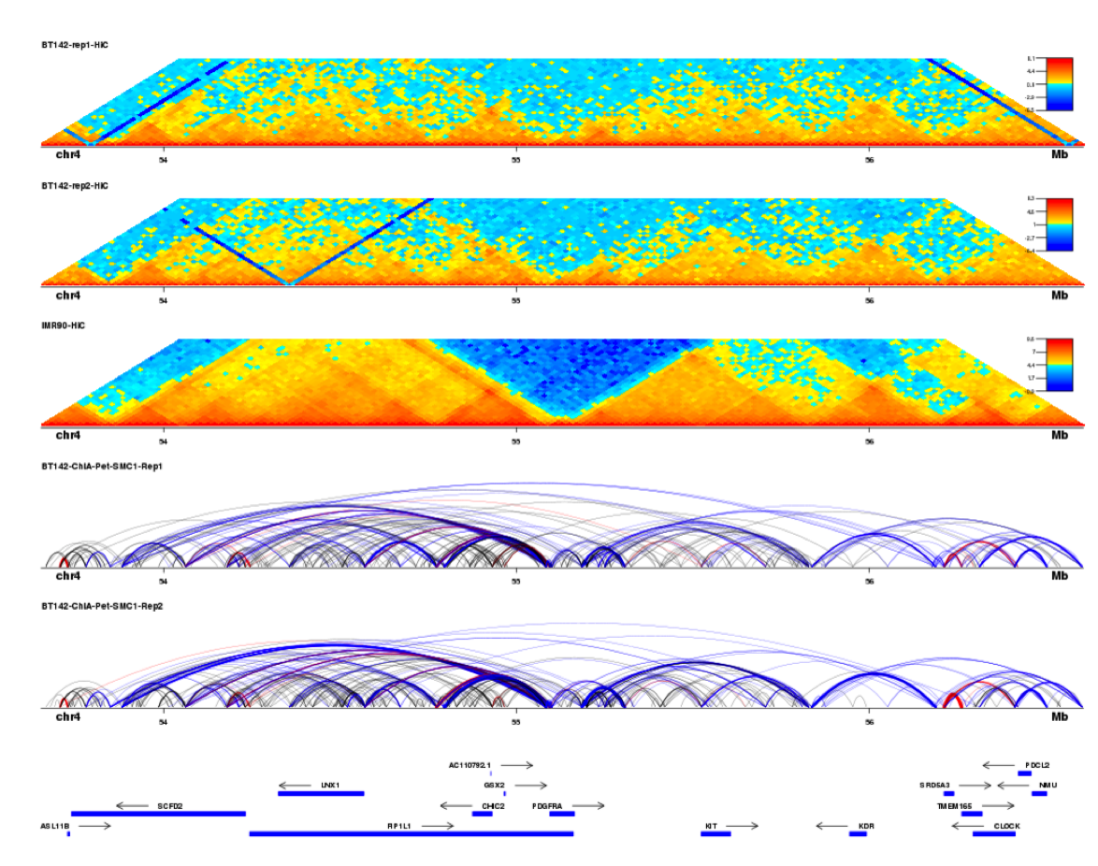
Hi-C
ChIA-PET

Slide 12
Shameless plug
dnalandscaper.aryeelab.org

Slide 13
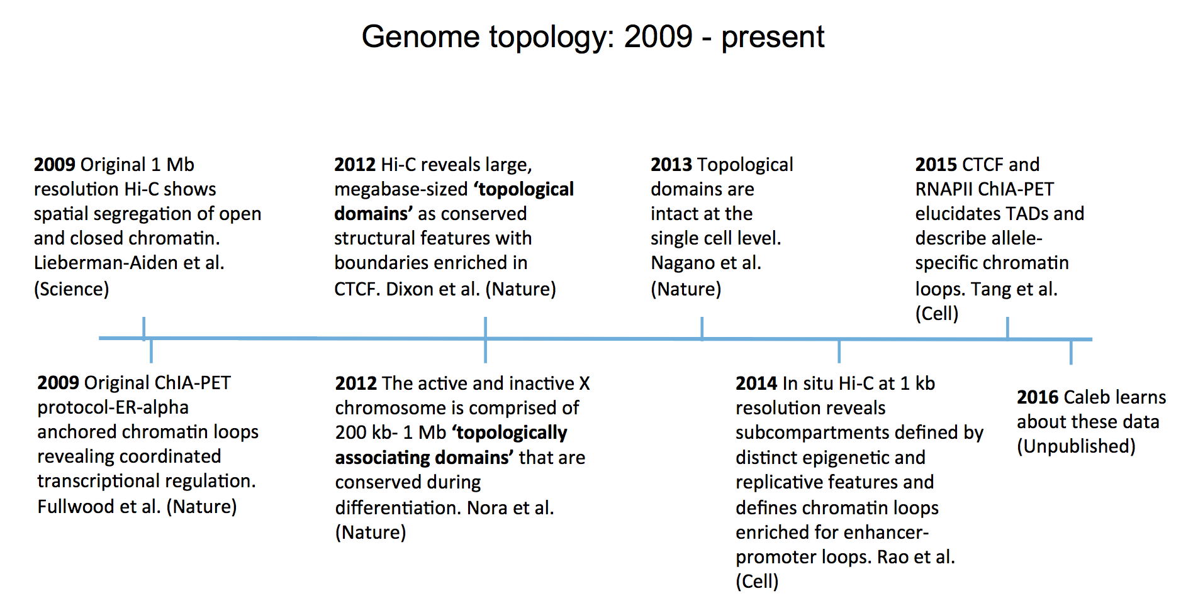
timeline
Today

Slide 14
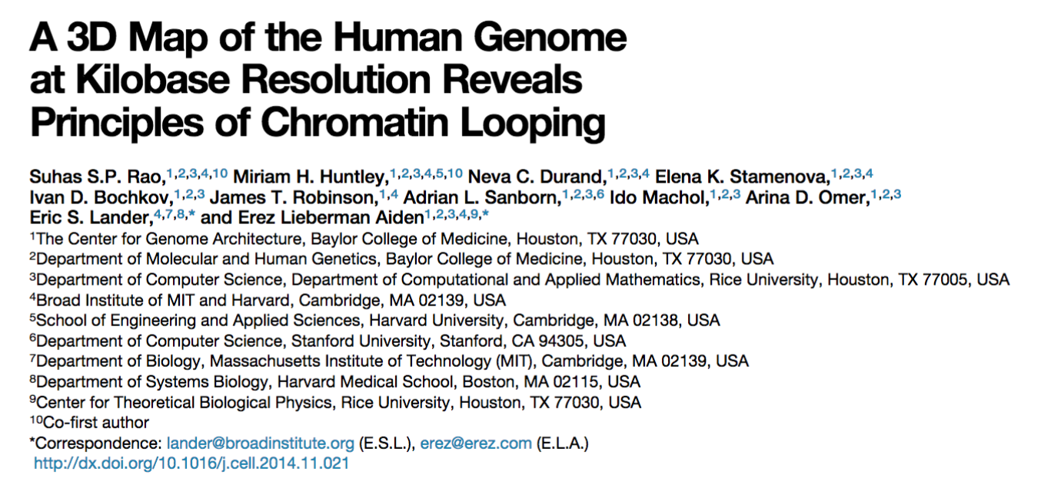

Slide 15
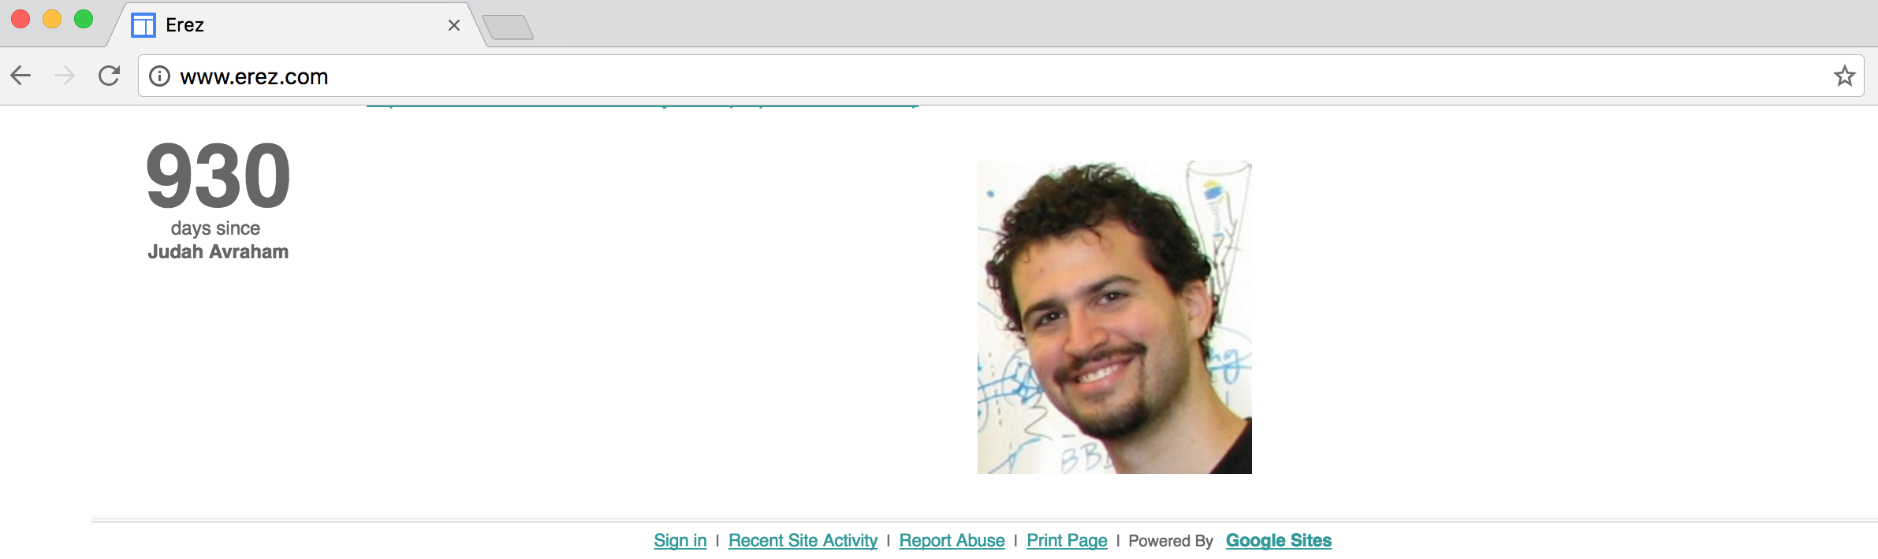
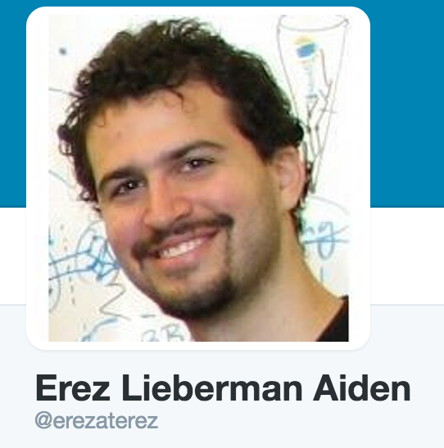

Slide 16
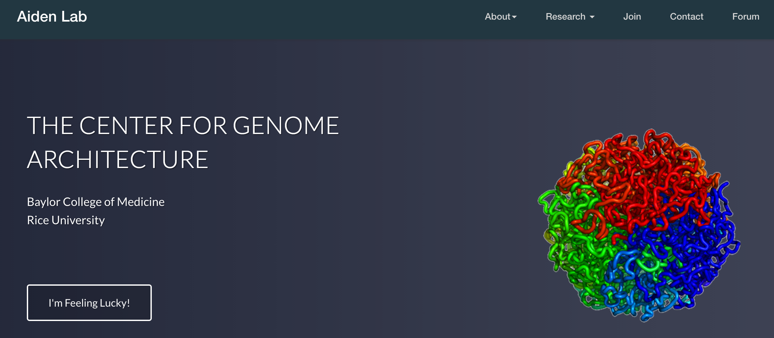

Slide 17
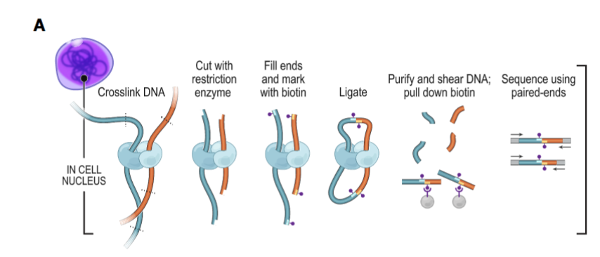
Importance of in situ
In situ

Slide 18
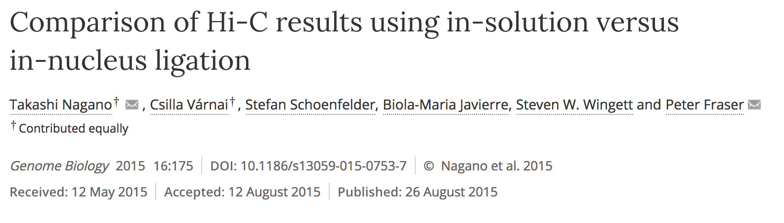
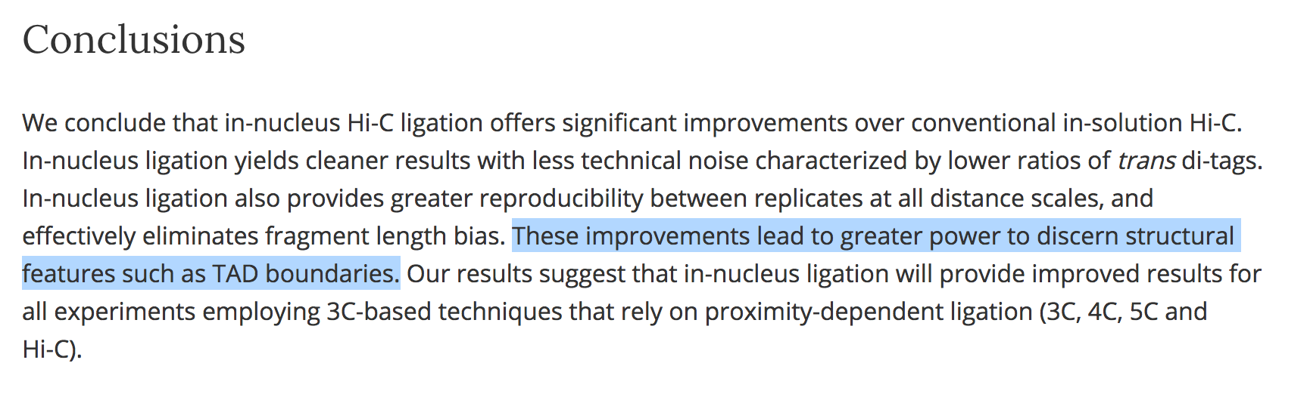

Slide 19
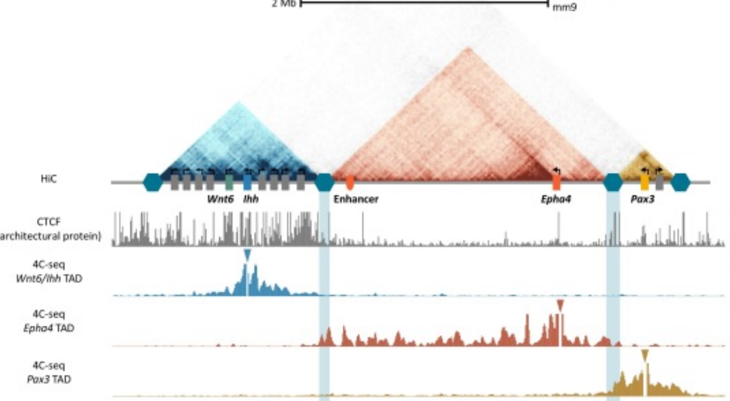

Slide 21
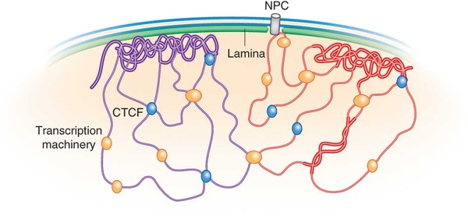
Subcompartments/Lamina
Repressed

Slide 22
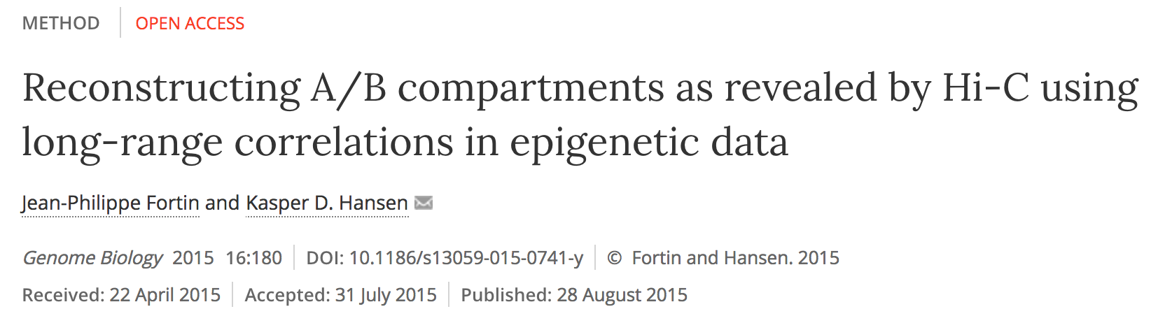
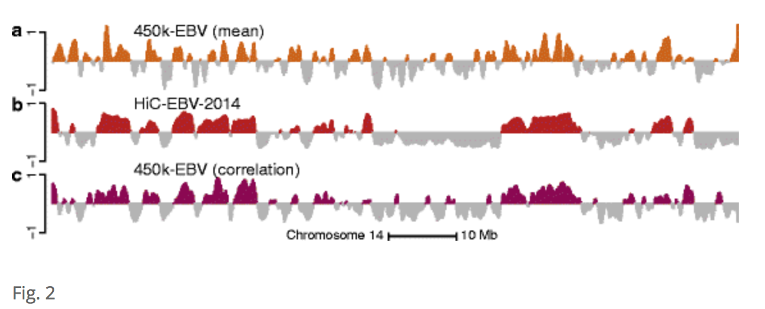

Slide 24
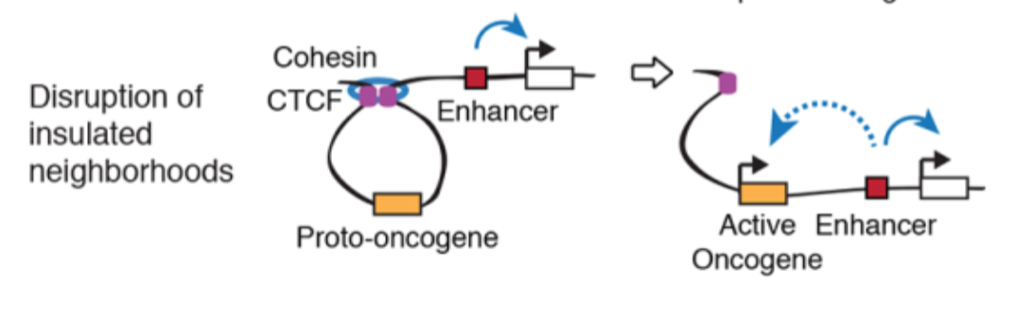
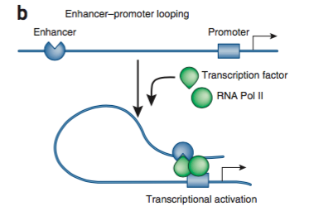

Slide 25
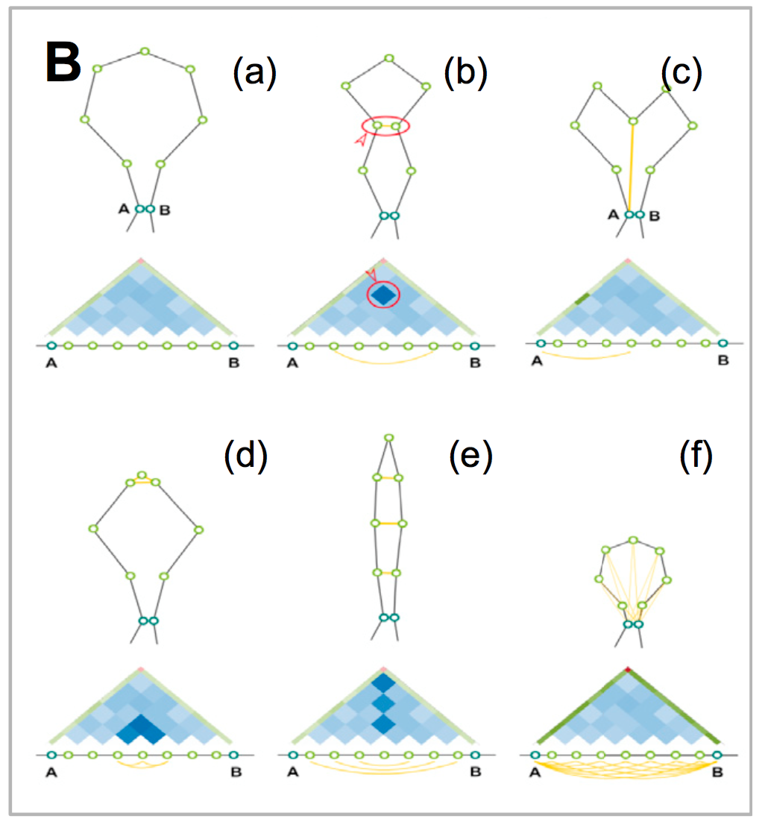
Loops

Slide 26
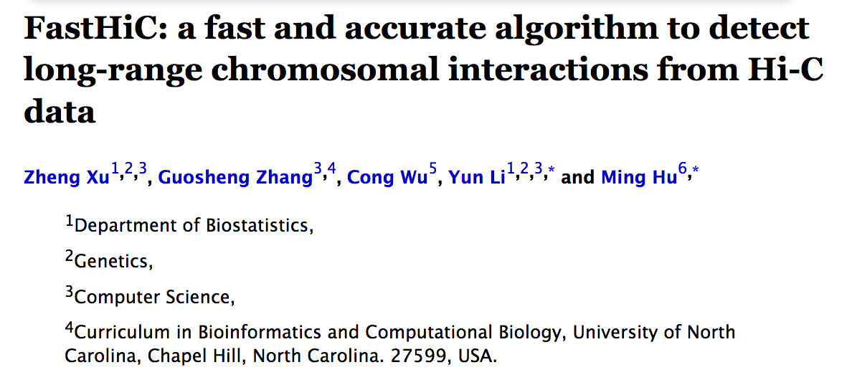
Loops

Slide 27
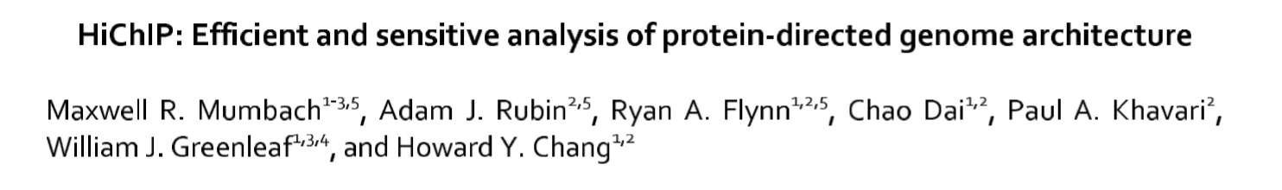
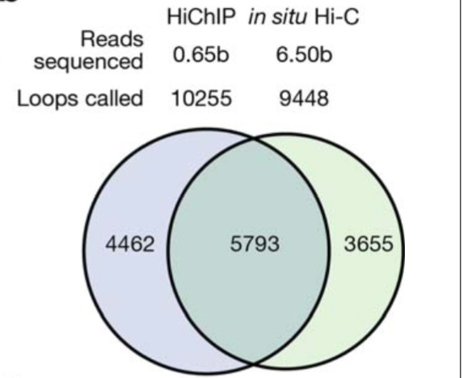
Loops

Slide 28
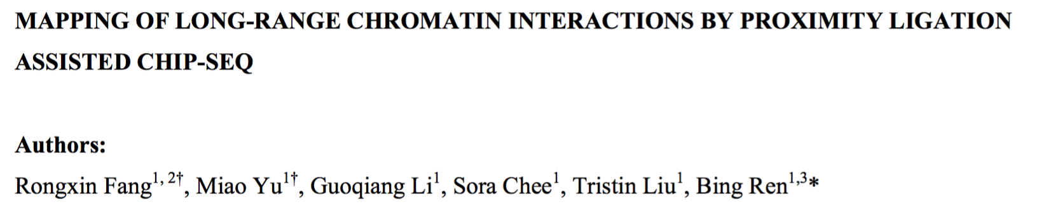
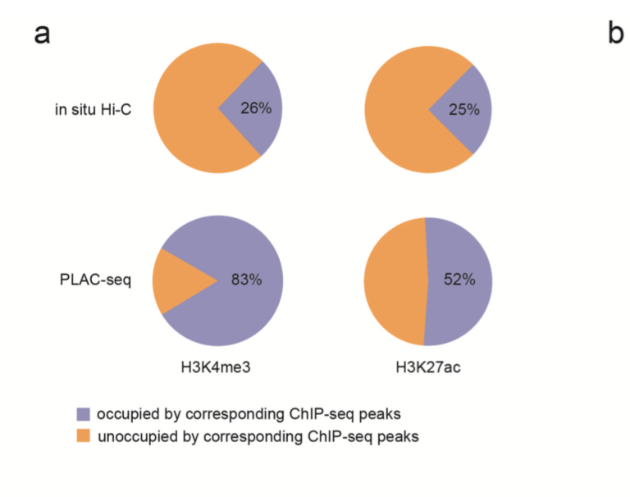

Slide 29
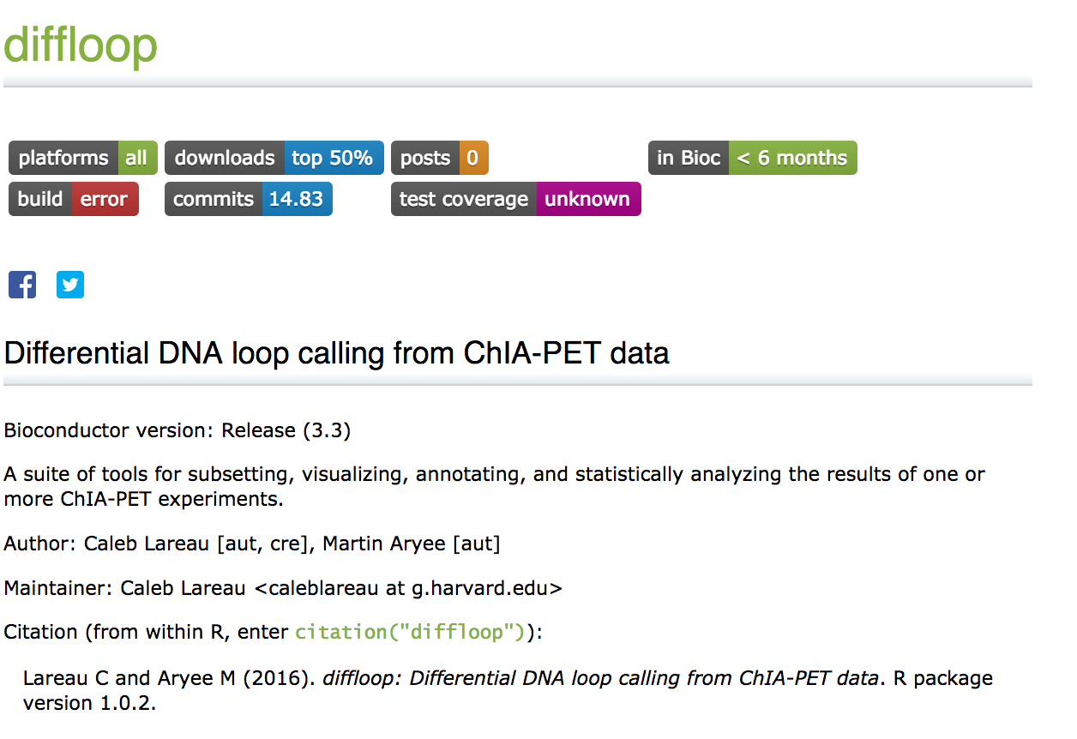
Shameless Plug 2

Slide 30
Definition of Resolution
A Hi-C map is a list of DNA-DNA contacts produced by a Hi-C experiment. By partitioning the linear genome into ‘‘loci’’ of fixed size (e.g., bins of 1 Mb or 1 kb), the Hi-C map can be represented as a ‘‘contact matrix’’ M, where the entry Mi,j is the number of contacts observed between locus Li and locus Lj. (A ‘‘contact’’ is a read pair that remains after we exclude reads that are duplicates, that correspond to unligated fragments, or that do not align uniquely to the genome.) The contact matrix can be visualized as a heatmap, whose entries we call ‘‘pixels.’’ An ‘‘interval’’ refers to a set of consecutive loci; the contacts between two intervals thus form a ‘‘rectangle’’ or ‘‘square’’ in the contact matrix. We define the ‘‘matrix resolution’’ of a Hi-C map as the locus size used to construct a particular contact matrix and the ‘‘map resolution’’ as the smallest locus size such that 80% of loci have at least 1,000 contacts.

Slide 32
Figure 1
In situ

Slide 33
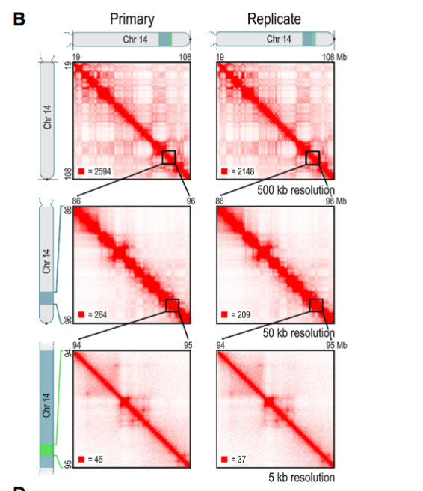

Slide 34
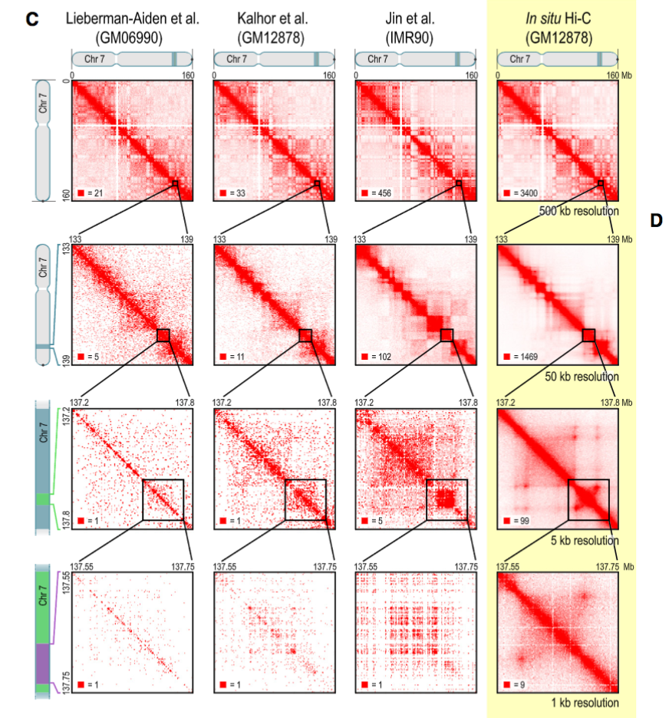

Slide 35
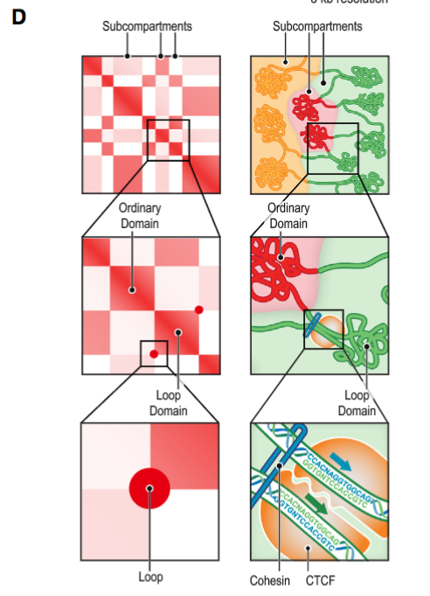

Slide 36
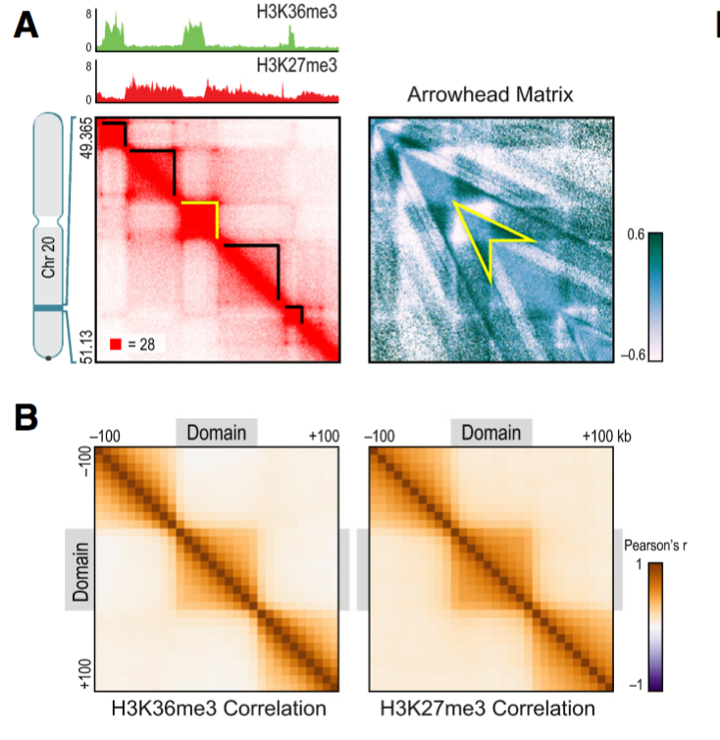
Figure 2

Slide 37
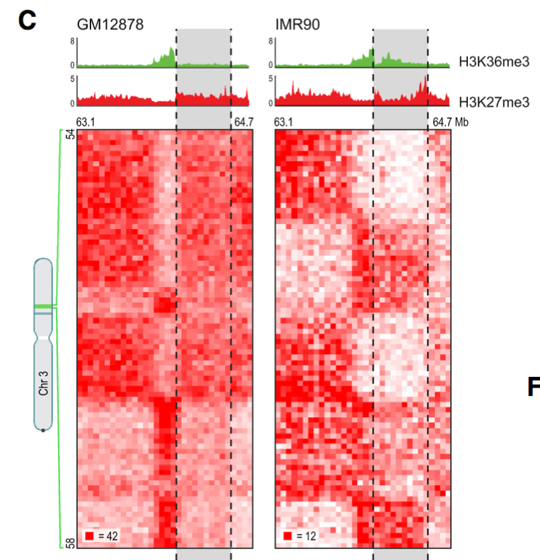
~ Active Transcription
Amplified
Repressed
~ Heterochromatin

Slide 38
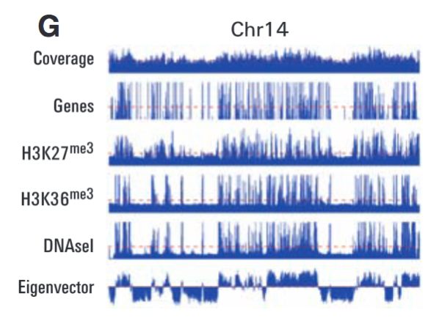

Slide 39
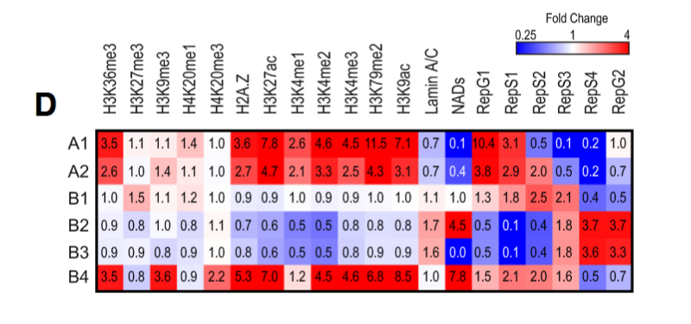
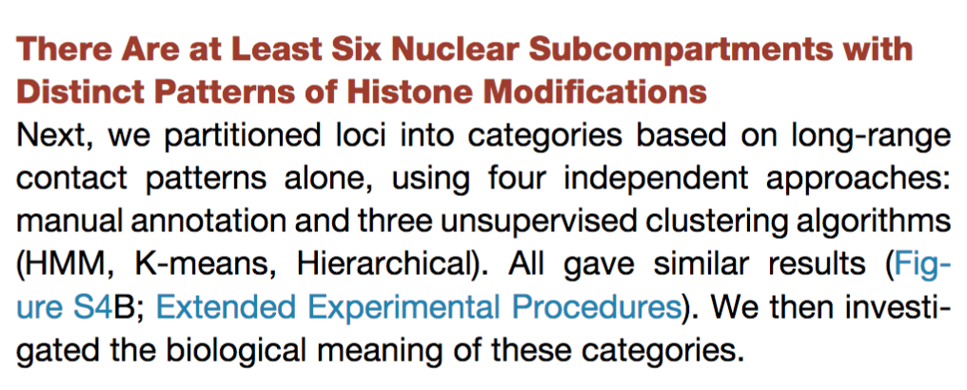

Slide 40
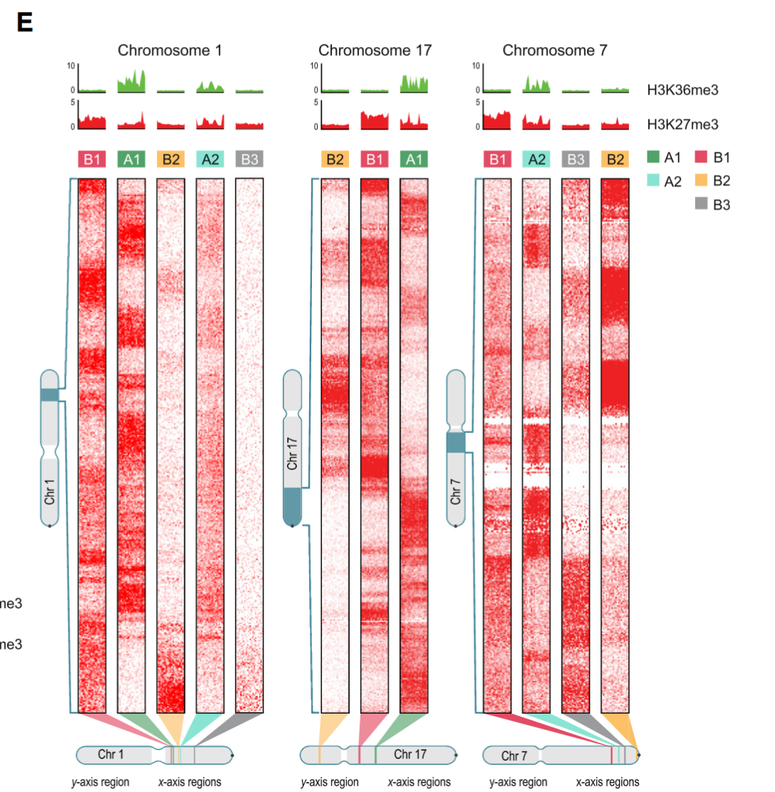

Slide 41
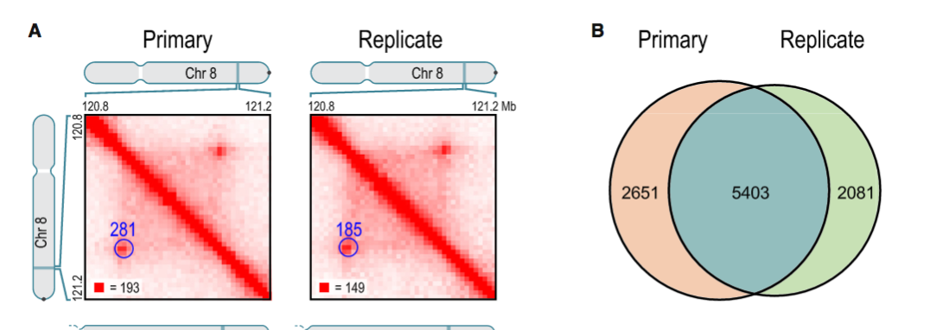
Figure 3

Slide 42
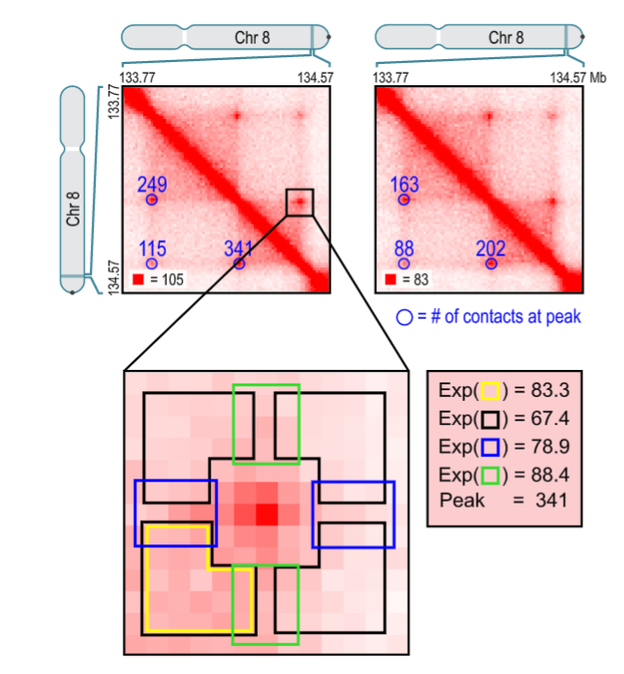

Slide 43
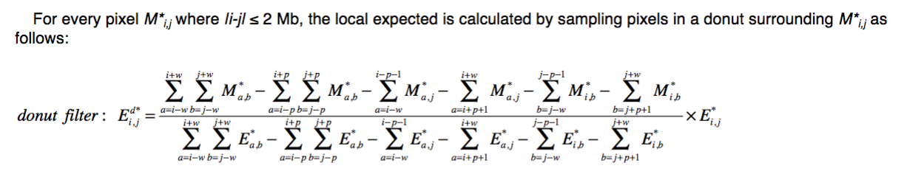
Local background… not global!

Slide 44
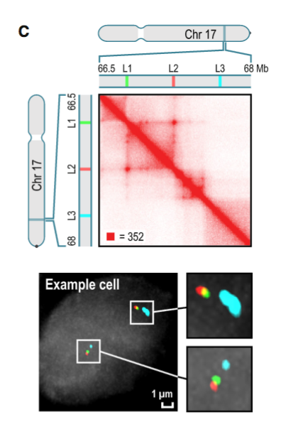

Slide 45
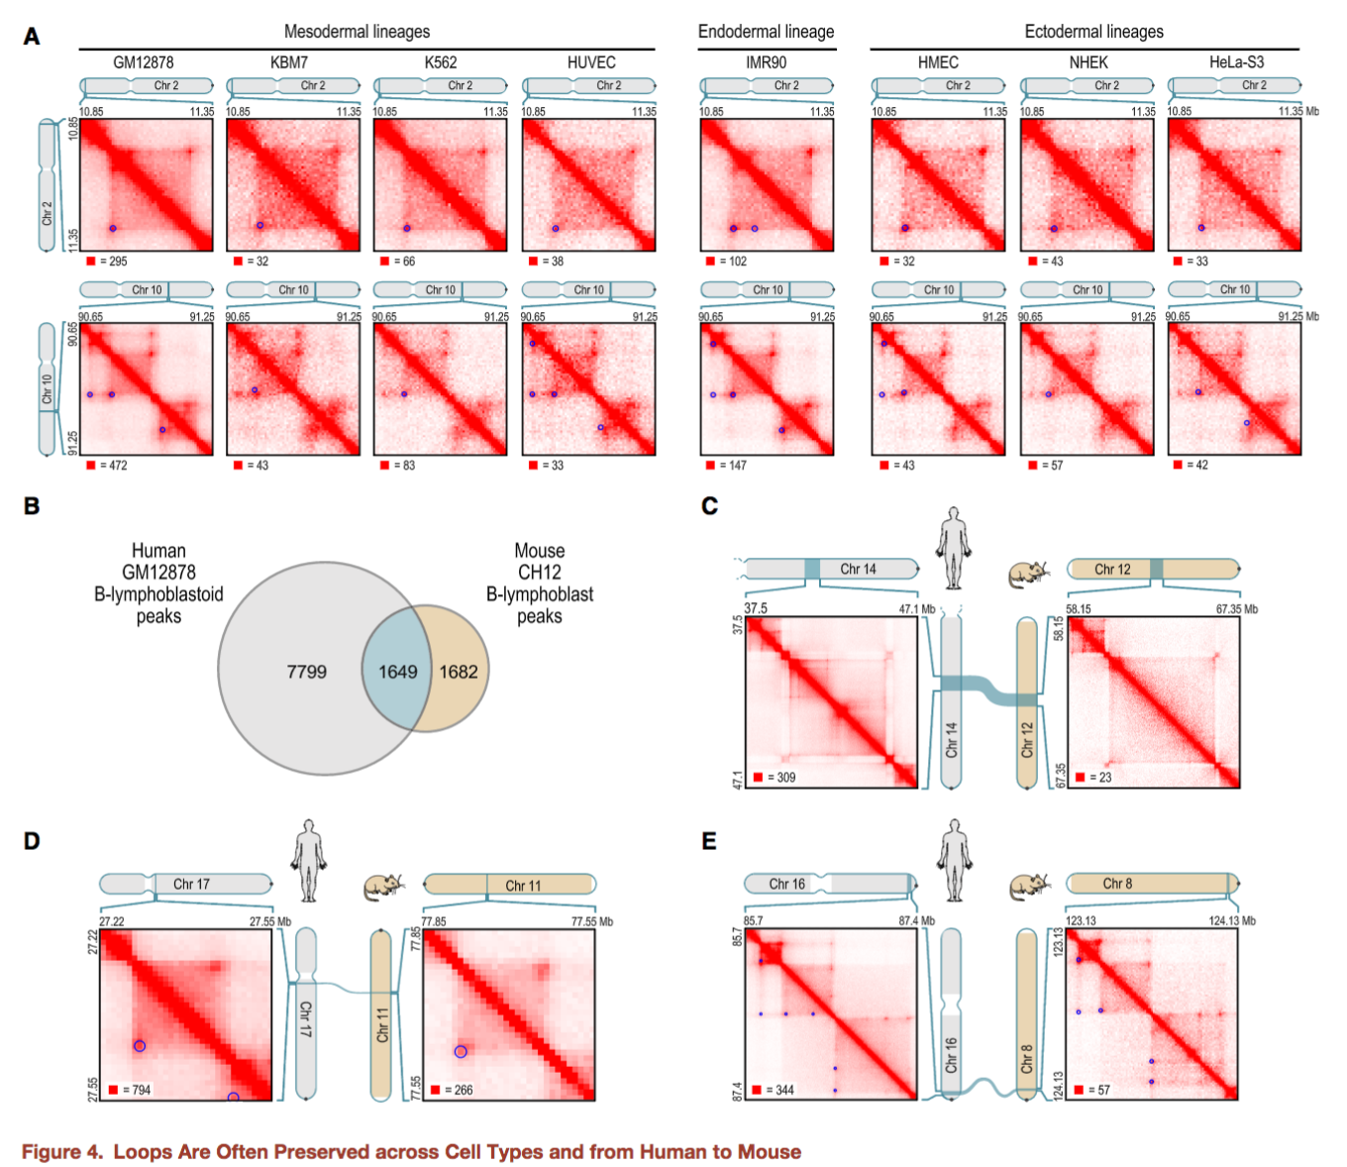
Figure 4

Slide 47
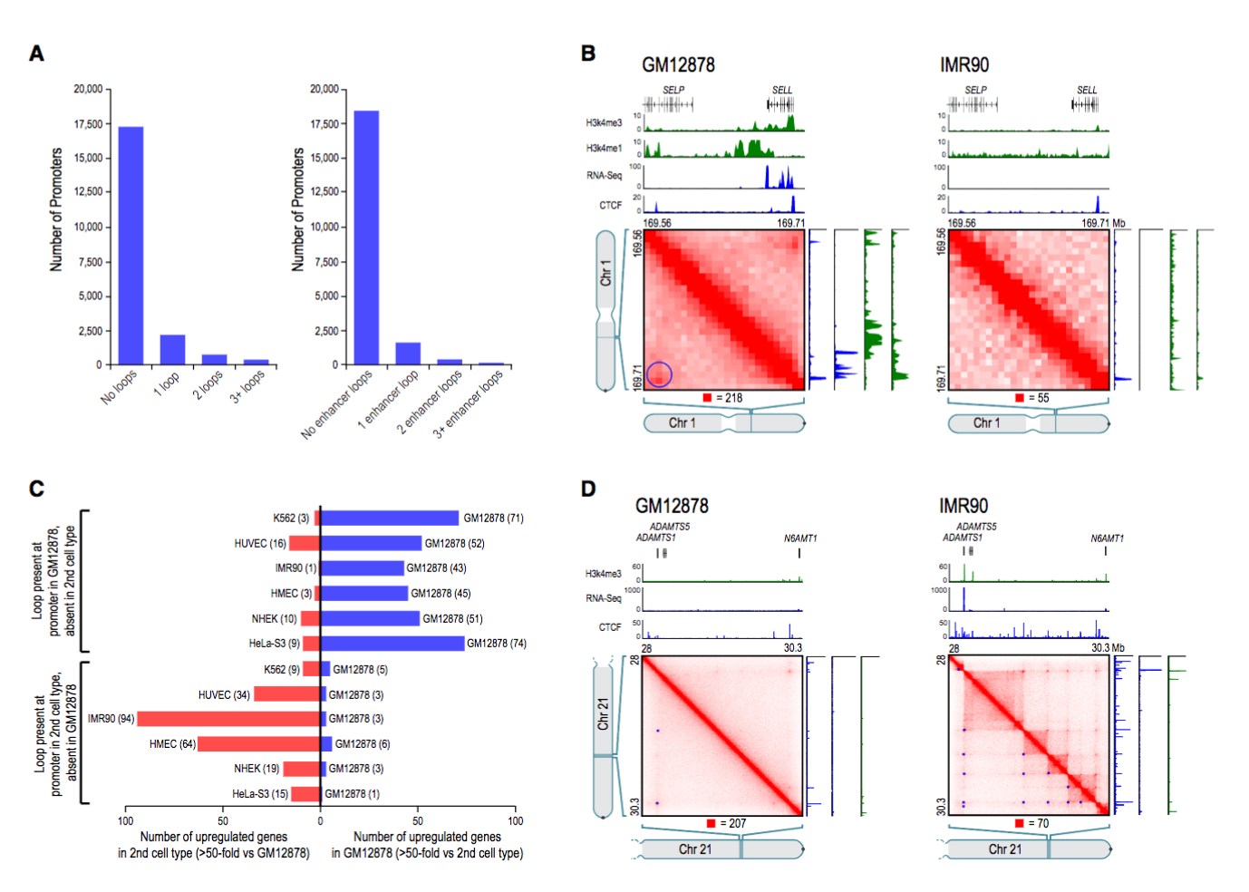
Figure 5

Slide 48
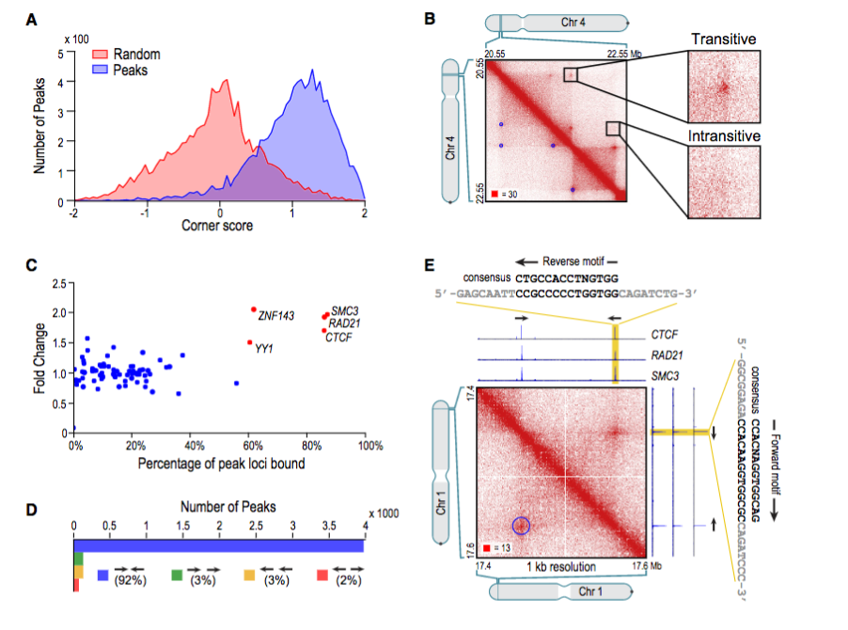
Figure 6

Slide 49
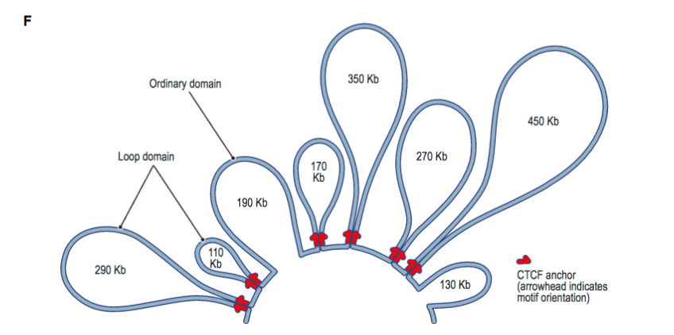

Slide 50
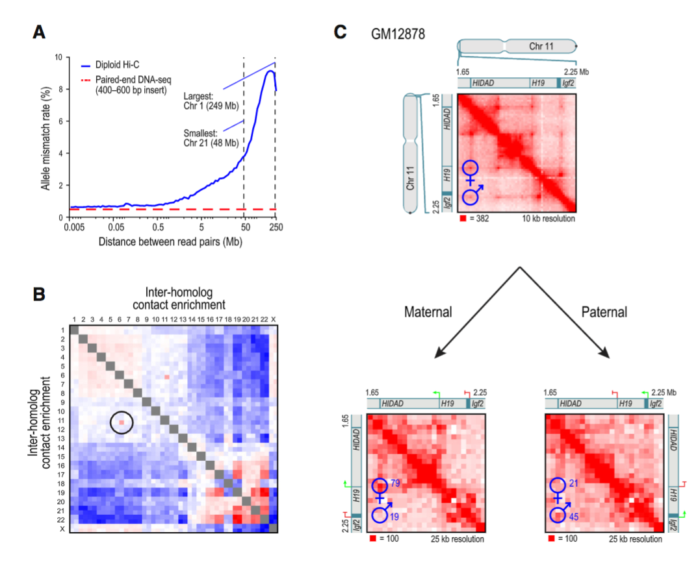
Figure 7

Slide 51
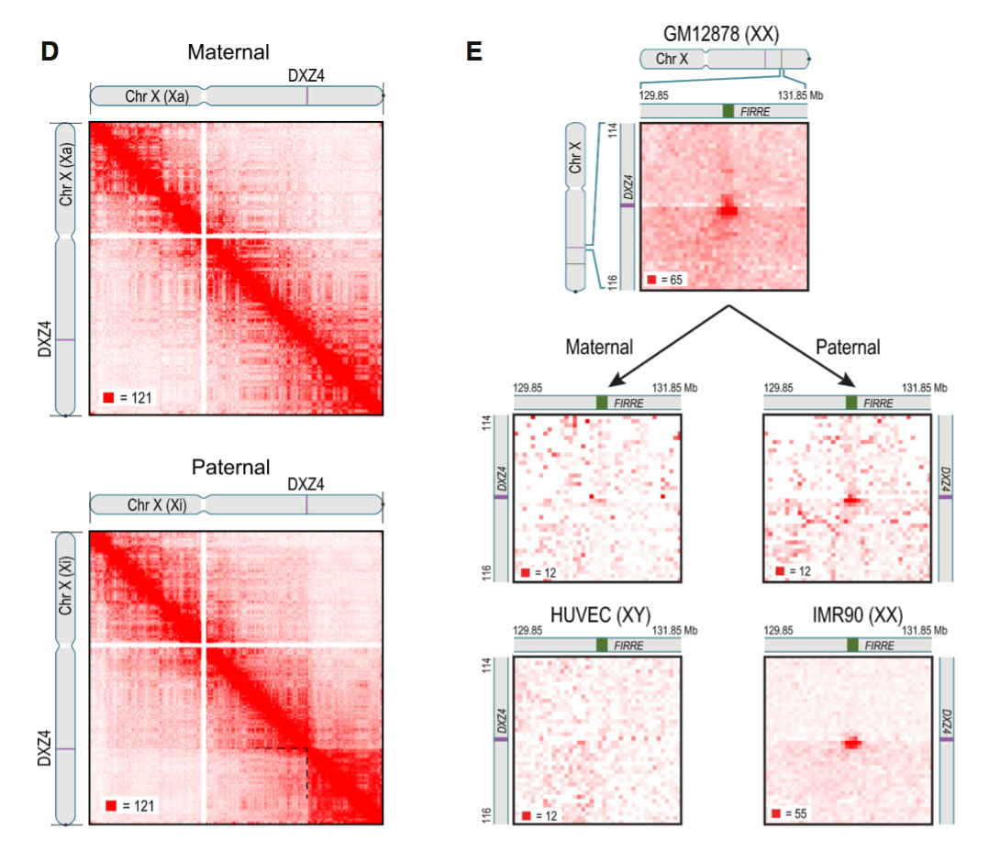

Slide 52
Conclusions
Rao et al. provided the highest resolution mapping of the 3D genome
3D genome important for disease (e.g. carcinogenesis)
Looping techniques aren’t the best
Computational
Experimental

Slide 53
Discussion

